Slide 1
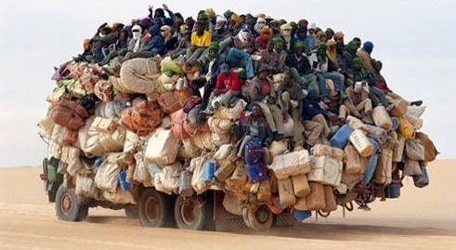

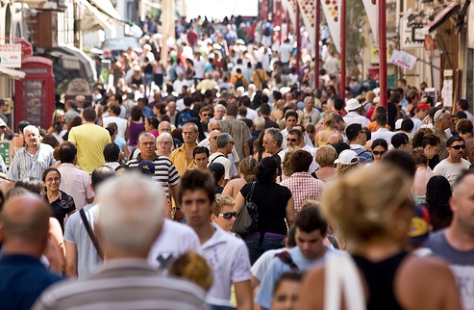
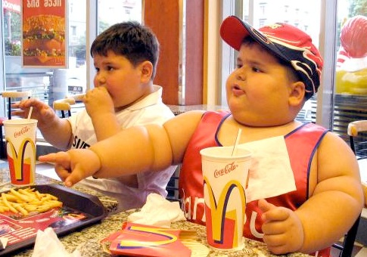
Overpopulation and overconsumption
Overpopulation
Over-consumption
Over- what?
Who me?
me?

Slide 2
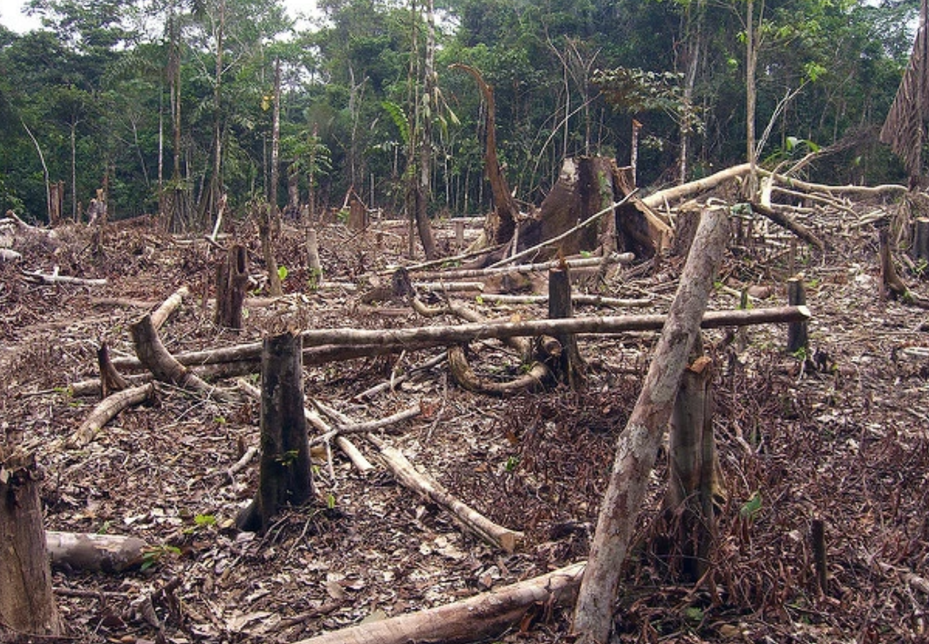

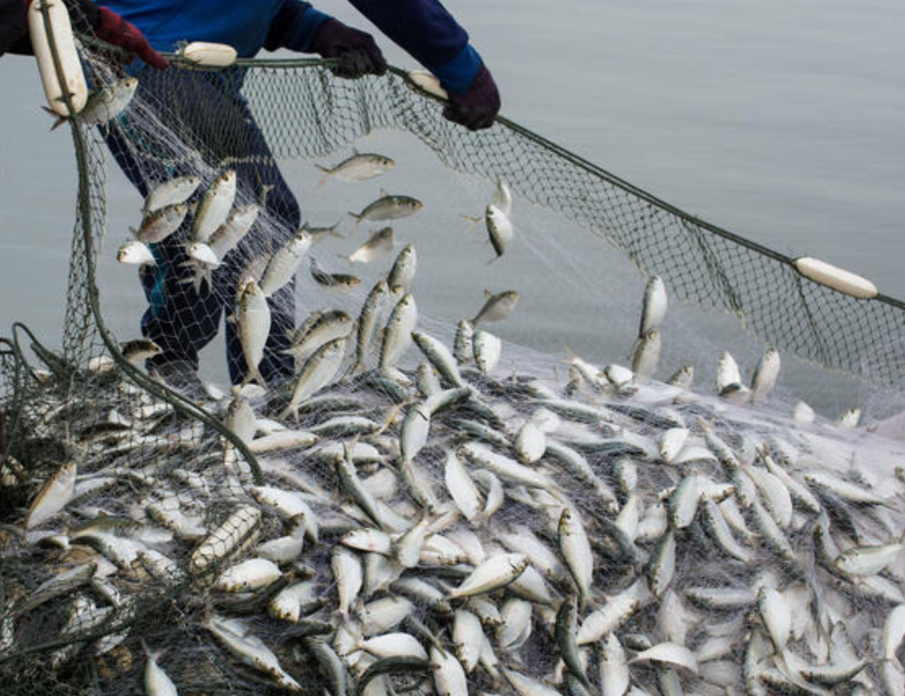
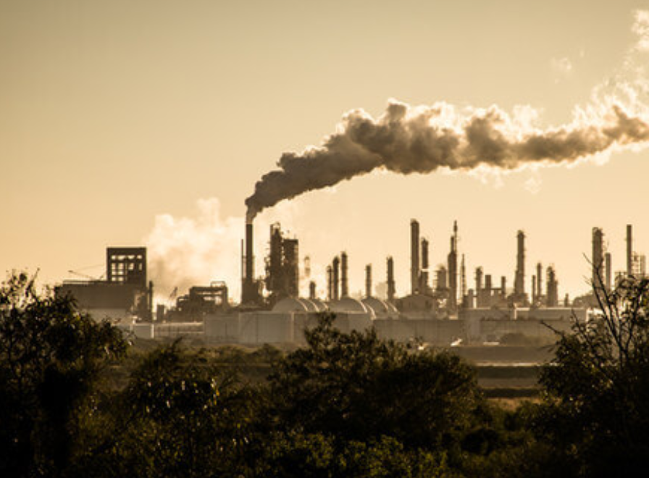
PROXIMATE
Deforestation
ULTIMATE
Overexplotation
Climate change

Slide 3

Framework of the biodiversity crisis
~8 billion people today
Education
Corruption
Inequity
Wealth
Too many humans
Housing
Food
Spatial expansion
Farming
Habitat loss
Exploitation
Biodiversity loss
83% of the world’s land surface affected by humans (Sanderson et al 2000)
100% of the world’s ocean affected and 41% strongly affected by human activities (Halpern et al 2008)
~70% of the world’s fisheries are fully fished, overexploited, depleted, or slowly recovering (FAO)
Notes:
Check if students see the error int he number of people

Slide 4
Is human density a driver of biodiversity change?
?
Biodiversity
Human population

Slide 5
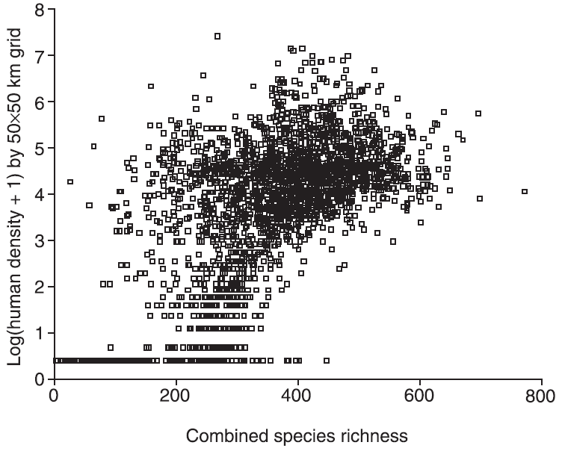
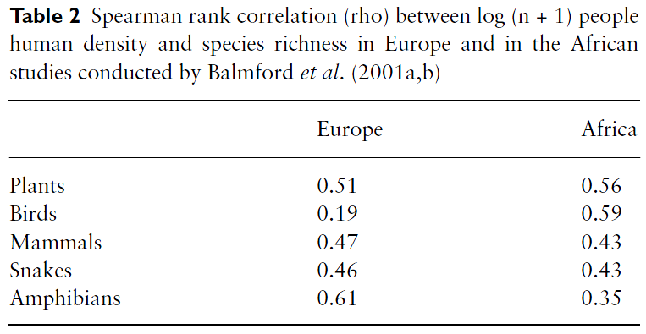
Spatial congruence between people and biodiversity
…so why is that there are more species where there are more humans?...
Hypotheses:
1) Human population and species richness both respond similarly to the underlying driver of energy availability (Gaston, Progress in Physical Geography 2005)
2) Human land transformation near settlements increases species richness. The net gain in species richness whereby the number of new species introduced to an area is greater than the number lost (McKinney, Global Ecology and Biogeography 2002)
3) Climate stability hypothesis. Glacier refuges allowed humans and species to persist in the same areas (e.g. Fjeldså & Rahbek, Conservation in a changing world 1998).
4) Disturbance hypothesis. Humans act as disturbances allowing the filtering of more tolerant species, while minimizing the role of dominance of few species (Araujo Global Ecology & Biogeography 2003)
Araujo (Global Ecology & Biogeography 2003)

Slide 6
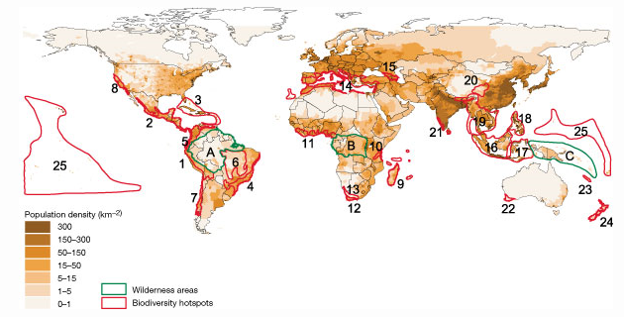
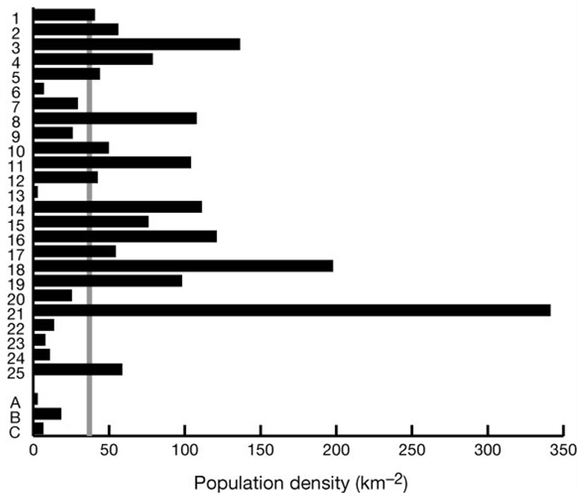
The fact is, however, that humans are concentrated in biodiversity hotspots
Global average
Hotspot average
In 1995, more than 1.1 billion people, nearly 20% of world population, were living within identified biodiversity hotspots, an area covering about 1.4% of Earth's terrestrial surface (Cincotta et al Nature 2000)
42
73

Slide 7
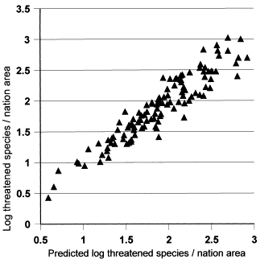
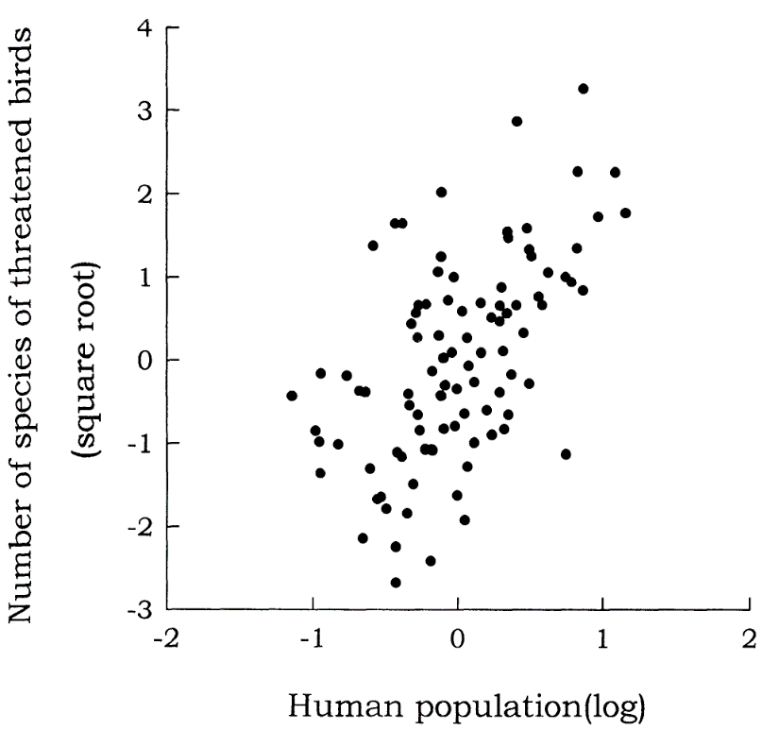
Regardless of the mechanism, the relationship between people and biodiversity brings several major challenges
1) Increase extinction risk
There is a high relationship between biodiversity and the number of threatened species
(McKee et al Biological Conservation 2004)
By chance alone, then, there will be more species at risk where there are more humans
(Kerr & Currie, Conservation Biology 1995)

Slide 8
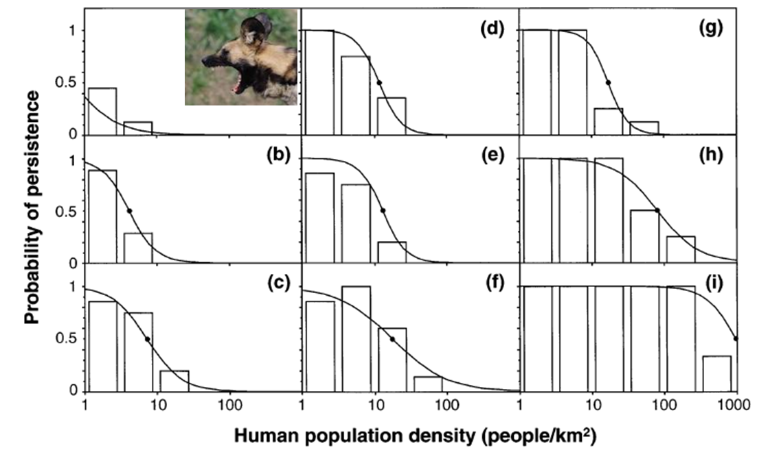








…and the evidence for accelerated extinction due to humans do exists…
Woodroffe (Animal Conservation 2000)

Slide 9

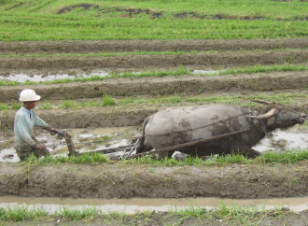
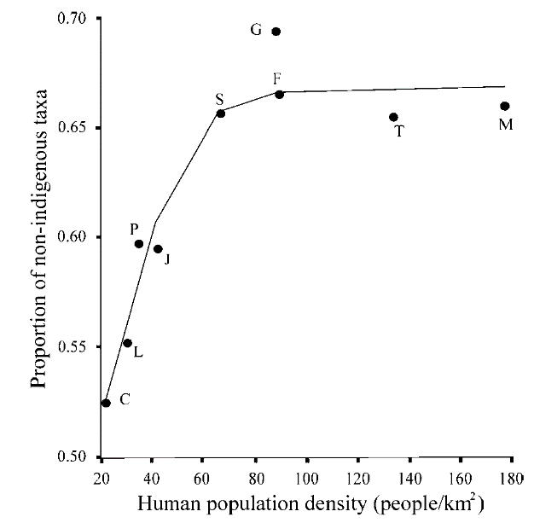

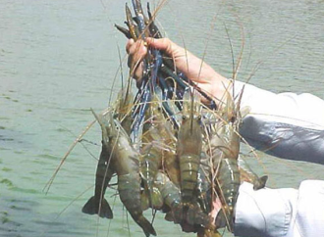

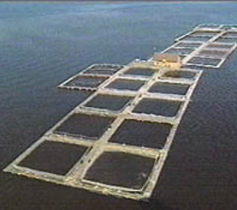

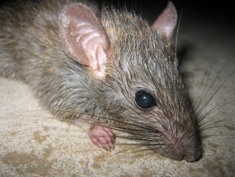
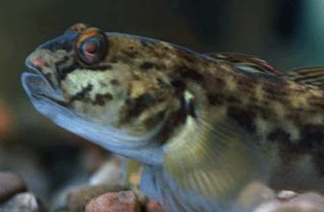
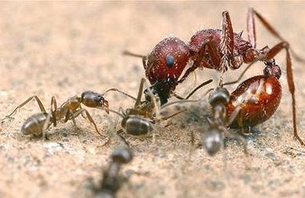
Regardless of the mechanism, the relationship between people and biodiversity brings several major challenges
2) Increased number of invasive species
Globalization, transport
Farming and culturing
More non-indigenous species are introduced to native habitats as a function of the number of people
- 54% of known extinctions in birds have been caused by invasive species (Clavero & Garcia, TREE 2005)
- Major cause of extinction in fishes in North American [i.e. 27 out of 40 sps. (Miller et al, Fisheries 1989)], world [i.e. 11 out of 23 spp. (Harrison & Stiassny (CREO 2004)
- Major cause of extinction in mammals [i.e. 12 out 25 spp (McPhee & Flemming CREO 2004)]
(Silva & Smith, Biological Invasion 2004)

Slide 10
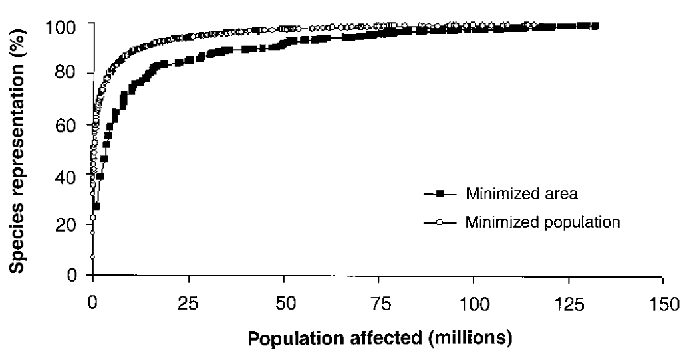
Regardless of the mechanism, the relationship between people and biodiversity brings several major challenges
3) Conservation conflicts
(Balmford et al, Science 2001)
If conservation legislation is applied strictly, the creation of protected areas could evict between 1 and 16 million people in Africa (Geisler and De Sousa, Public Administration and Development 2001), nearly 4 million in India (Kothari 2004) and 400 million globablly (Mora & Sale 2011)

Slide 11
Framework of the biodiversity crisis
6 billion people today
Education
Corruption
Inequity
Wealth
To many humans
Housing
Food
Spatial expansion
Farming
Habitat loss
Exploitation
Biodiversity loss

Slide 12
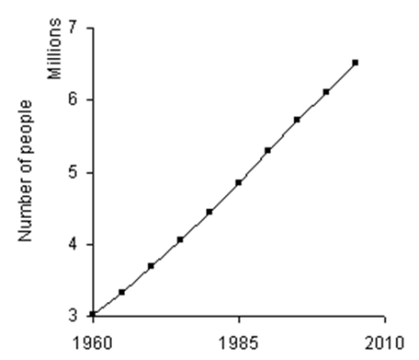
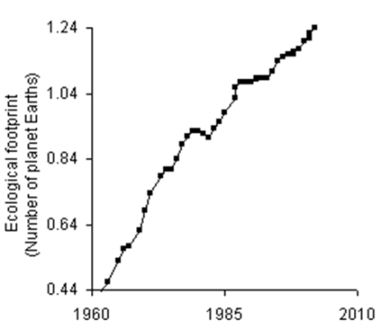
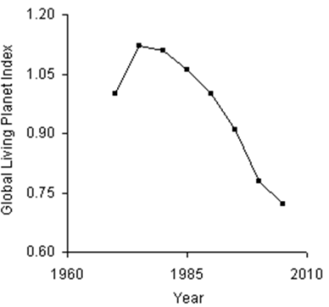
The human factor accelerating extinction may not necessarily be the number of people: consumption
(UN Global human population prospects 2009)
Human population
Household
Food
Energy
Habitat loss
Overexploitation
Climate change: Warming, Acidification, catastrophic weather
Pollution: sewage, erosion, eutrophication
Invasive species
Protected areas
Quota limits
CO₂ caps
Alternative energies
Education awareness
Treatment plants
Manual controls
Traffic reduction
Biodiversity status
(Mora & Sale MEPS 2011

Slide 13
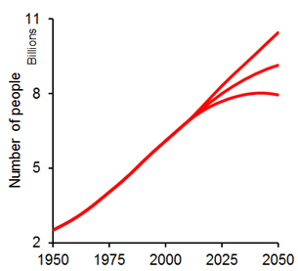
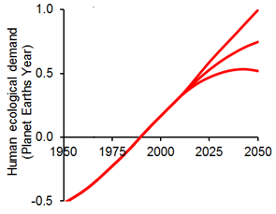
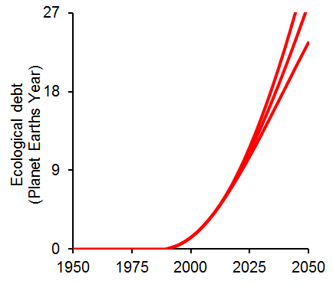
Scenarios of human consumption and population
12 in Saudi Arabia
9 in the USA
0.68 in Haiti
x Average per capita consumption: 2.1 global hectares a year
/Earth’s biocapacity: 11 billion global hectares a year
Overshoot
All Earth’s biocapacity already consumed
Mora & Sale, MEPS 2011

Slide 14
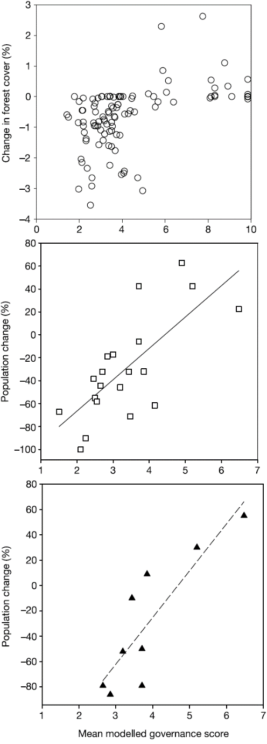
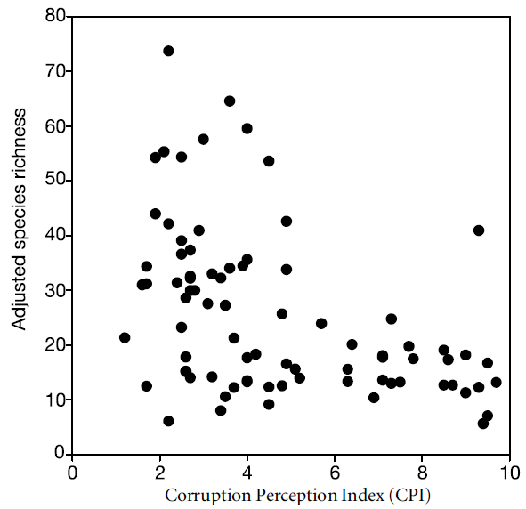

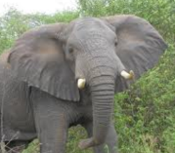
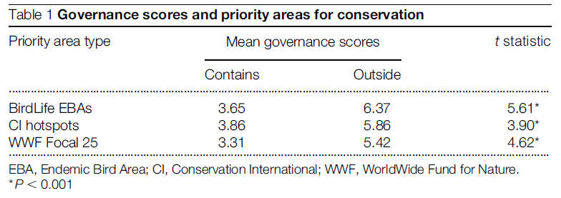
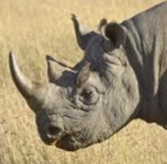
The human factor accelerating extinction may not necessarily be the number of people: Governability
Unfortunately, most commonly species-rich-countries have the lowest of all governability
(Smith et al, Nature 2003)
Well identified biodiversity hotspot are located on areas of higher corruption
Black rhinoceroses
(Smith et al, Nature 2003)
(Smith et al, Nature 2003)

Slide 15
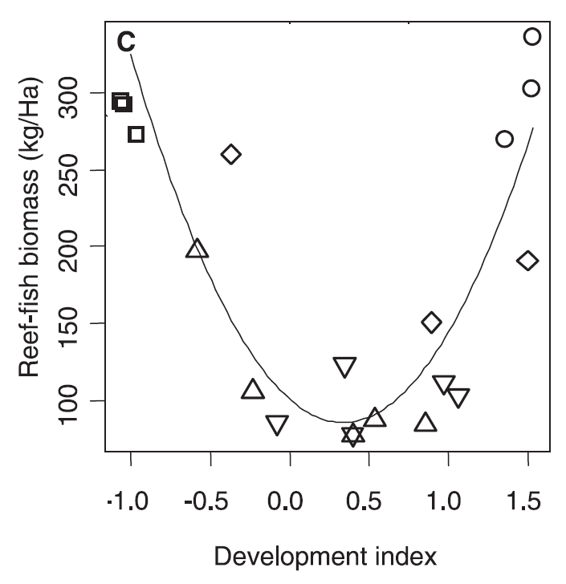
The human factor accelerating extinction may not necessarily be the number of people: Development
You have to start here
To get here
The paradigm of development and biodiversity protection
(Cinner et al. Current Biology 2008)
Kuznets environmental curves: more developed societies, with larger incomes become more environmentally friendly

Slide 16
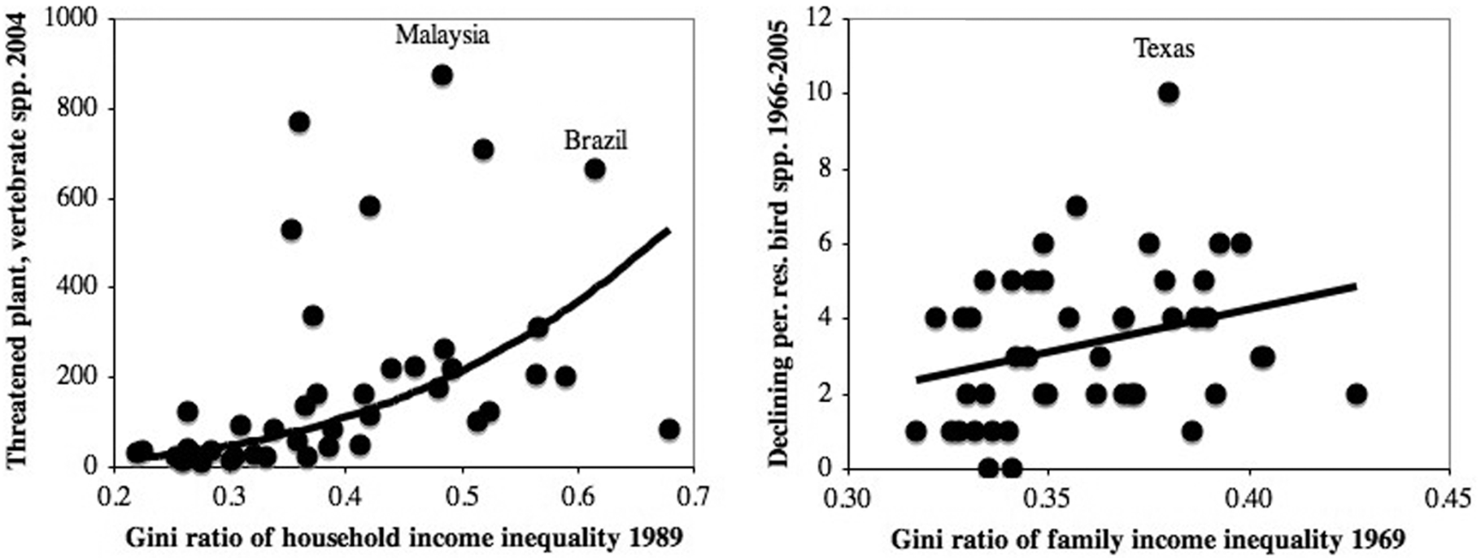
The human factor accelerating extinction may not necessarily be the number of people: Inequity
Within countries
USA states
(Mikkelson et al, PlosOne 2007)
Considerable inequality can thwart the collective action required for environmental protection

Slide 17
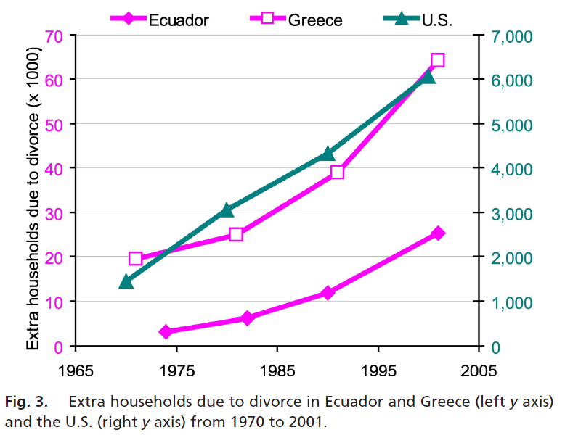
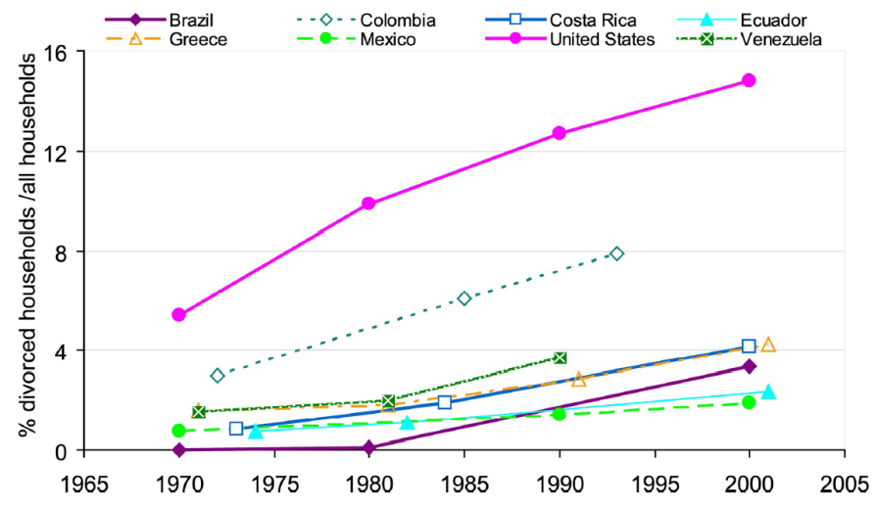
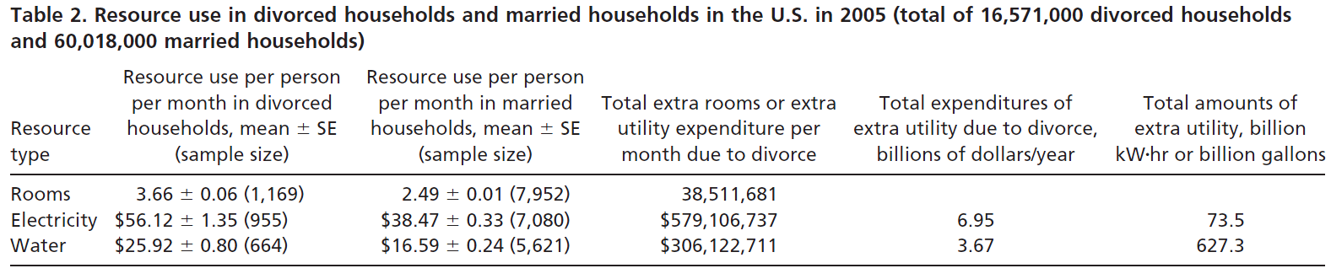
The human factor accelerating extinction may not necessarily be the number of people: Marital divorce
More divorces more households
Unfortunately, divorces are increasing widely
More resources used, more biodiversity deteriorated
More households more of everything
(Yu & Liu, PNAs 2007)

Slide 18
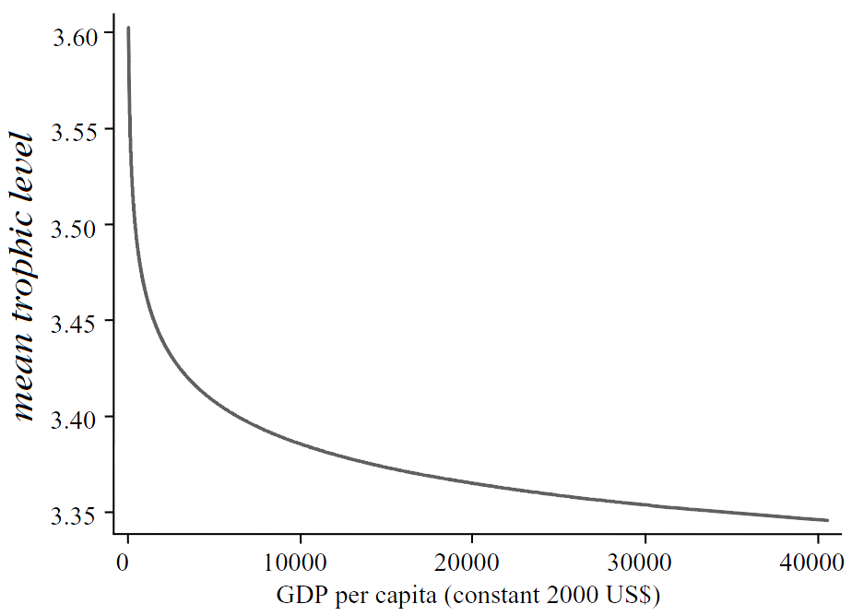
The human factor accelerating extinction may not necessarily be the number of people: Wealth
I disagree
Clausen & York (Conservation Biology 2008)
…me, too…
More money equals more power of acquisition and/or consumption equals more pressures on natural resources
Total demand for fisheries products is likely to increase by approximately 35 million metric tonnes by 2030 (i.e. 43% of the maximum reported catch in the late 1980s) as a result of increasing wealth and consumptive power of developing nations (mostly China and India) (Delgado et al, Outlook for
fish to 2020 2003)

Slide 19
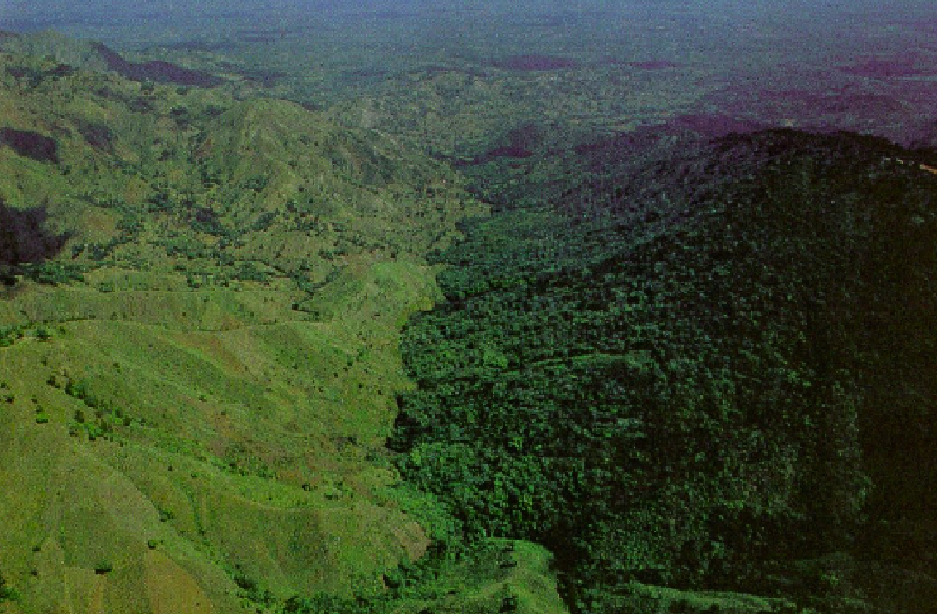
…so which factor it is?...
Haiti
Dominican Republic
361 people/km2
208 people/km2
Population growth rate = 1.838%
Population growth rate = 1.489%
Infant mortality rate = 60/1000
Infant mortality rate = 26/1000
Life expectancy at birth = 60.78 years
Life expectancy at birth = 71.88 years
HIV infections = 2.2 % of population
HIV infections = 1.1 % of population
Literacy = 52.9%
Literacy = 87%
Corruption perception Index = 1.8
Corruption perception Index = 3
Per capita GDP = $1,317
Per capita GDP = $8,672
…clearly there is a need to understand the interlink between human factors and their effects on biodiversity…

Slide 20
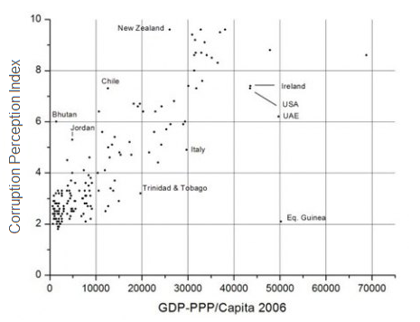
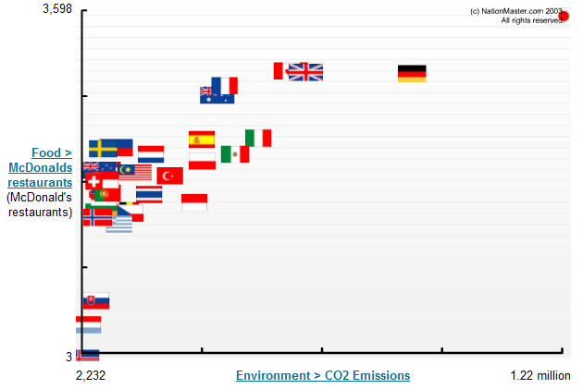
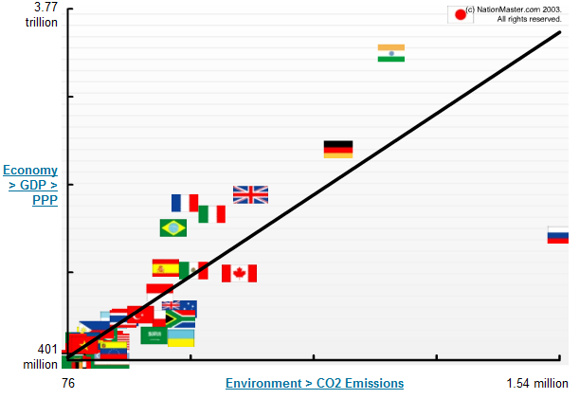
…so which factor it is?...
Obviously, many human factors correlated to each other
Correlation does not imply causality
Need for comprehensive studies into the mechanisms through which humans affect biodiversity
The so-called linked social-ecological systems

Slide 21
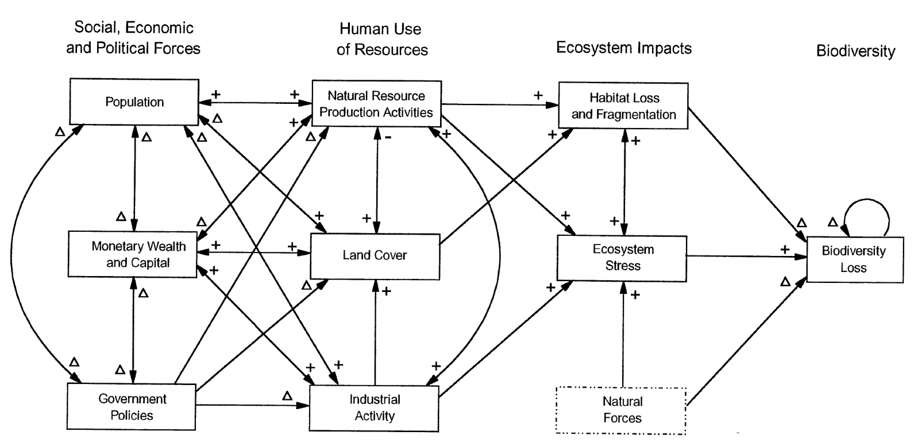
The human factor accelerating extinction may not necessarily be the number of people: couple social-ecological systems
(Forester & Machlis, Conservation Biology 1996)

Slide 22
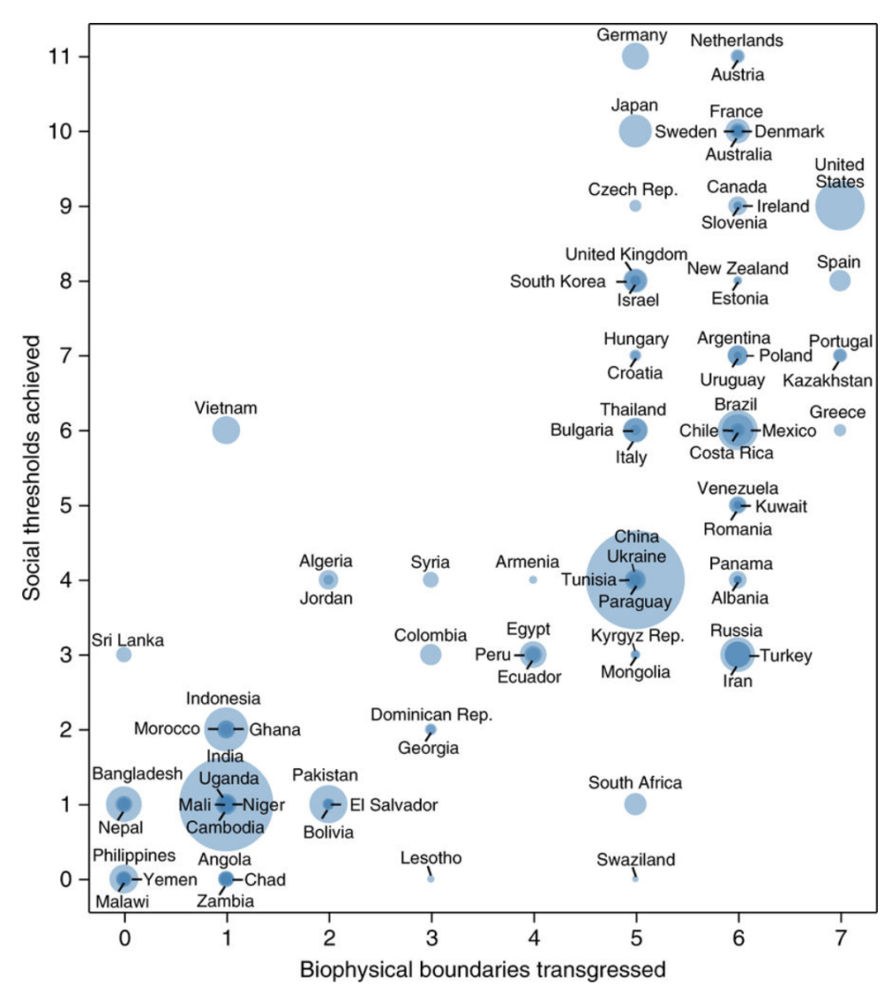
Our current conundrum, at current number, ensuring good quality of life for all can ruin the planet
(O’Neil, Nature Sustainability 2017)

Slide 23
…in summary…
Humans do affect biodiversity
How exactly is still unknown

